Slide 1


Team Members Mahak Bhatia(002922284) Sagar Malhotra (002926660) Samhitha Siddigari (002937064) Jui Anil Chavan 02963688) Gauri Bhale (002955836)

Slide 2
Team Contribution:
Mahak Bhatia(002922284)
Module - Onboarding, Registration DML/DDL - Table creation, Triggers, Onboarding Packages, Insertion
Sagar Malhotra (002926660)
Module - Onboarding, Registration
DML/DDL - User Creation / Removal, Onboarding DML Procedures, Onboarding DML Insertion
Samhitha Reddy Siddigari (002937064)
Module – Fee, Grade, Department & Course DML/DDL - Index, Onboarding Insertion, Student Test Cases
Jui Anil Chavan (002963688)
Module – Fee, Grade, Department & Course
DML/DDL - Sequence Creation, Onboarding Insertion, Professor Test Case
Gauri Bhale (002955836)
Module – Fee, Grade, Department & Course
DML/DDL - Grant Access, Views, Sequence Drop, Onboarding Insertion

Slide 3

Problem Background
A course management system is an integrated information system designed to manage the administrative aspects of an educational system to register or drop the class.
Streamline processes within the registration system, reduce student waiting time, and improve efficiency without visiting the office.
Reduce administrative times and duplication of information across the course registration information systems.
If a properly managed system is not built then dropping a class after registration could be cumbersome.

Slide 4
Problem Statement
Considering the number of users involved in the course management module it is arduous to keep a track of all the user types, their privileges, and responsibilities.
Managing classes and their registration deadlines manually could be a monotonous and time consuming task.
Maintaining a record of courses, classes, departments, professors, and students would be difficult without a centralized database.
If a properly managed system is not built dropping a class after registration could be cumbersome.
User registration and onboarding processes would be adversely affected if no proper user authorization is done.

Slide 5

Problem Solution
Records are easily stored as all the users are onboarded by the administrator and perform their desired operations as per the access provided.
Data redundancy will be avoided using primary key constraints on specified fields for every entity.
Data Maintenance is efficient and manageable as the proposed database will have separate entities for all the aspects with proper relationships between them using foreign keys and joins.
Records can be accessed easily and quickly using SQL queries as per the user requirements
Data Integrity and authenticity are maintained as user privileges and roles are defined. Moreover, data is accessible only to authorized users.

Slide 6

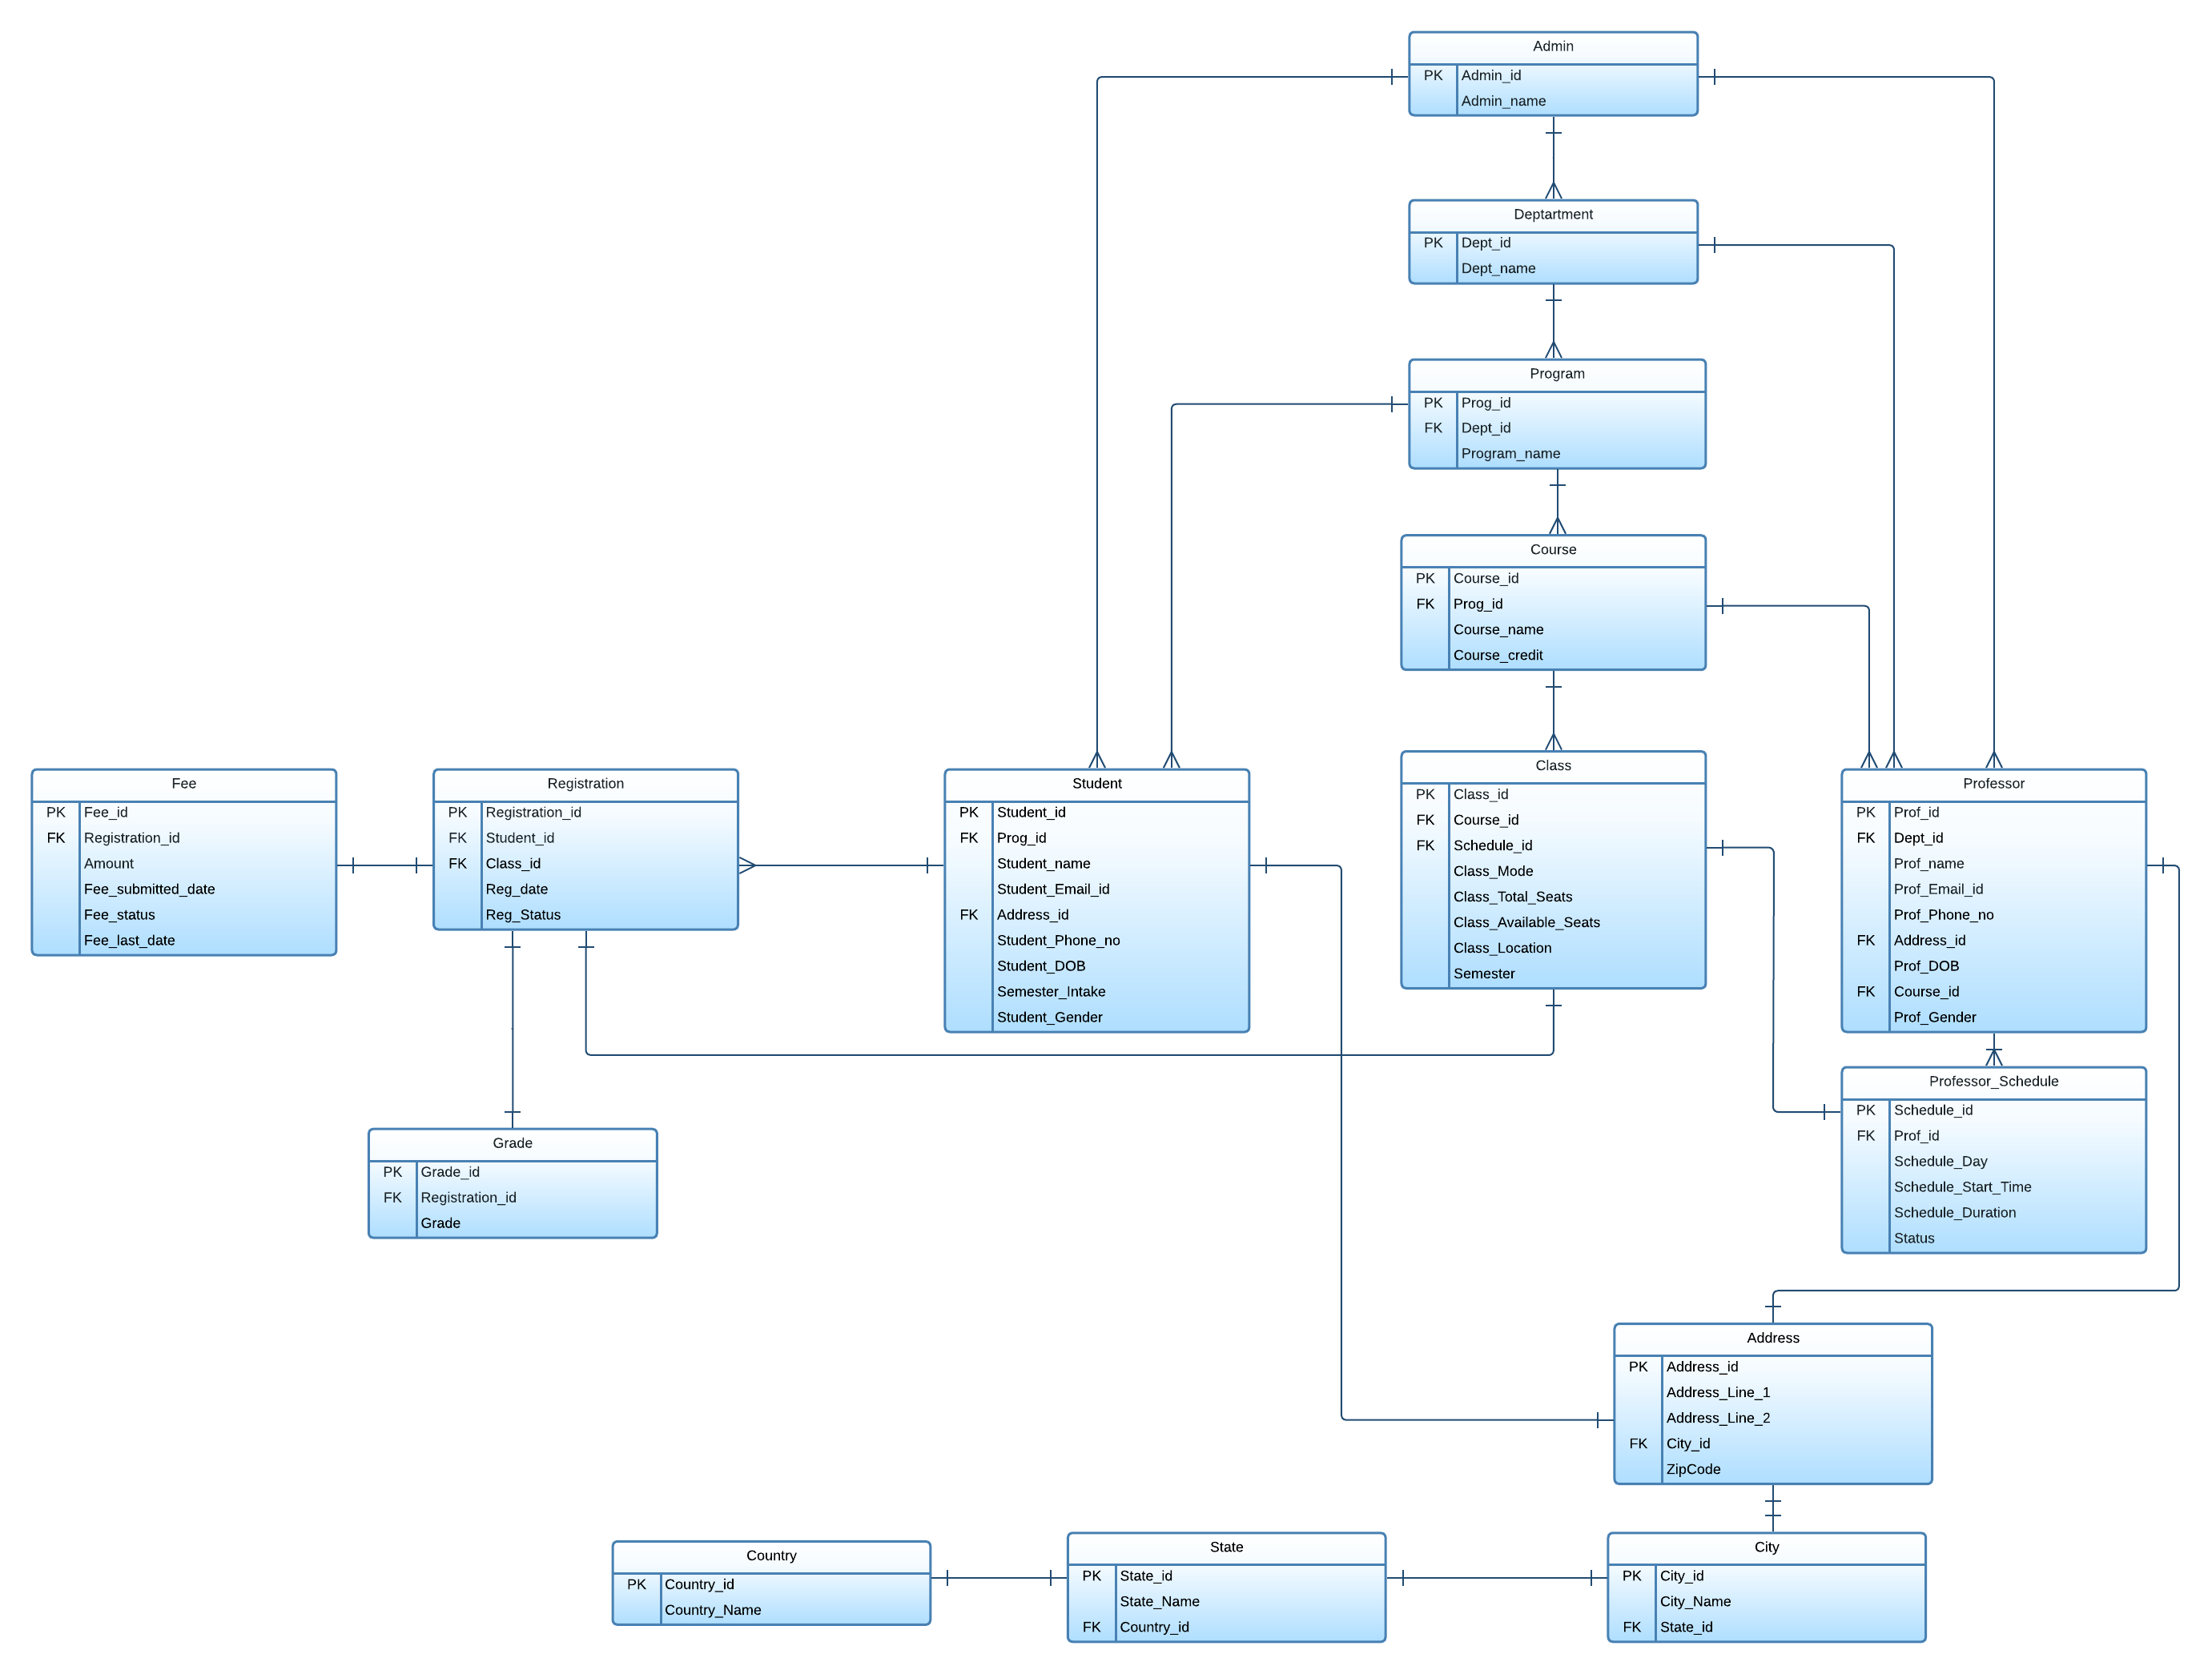

Slide 7

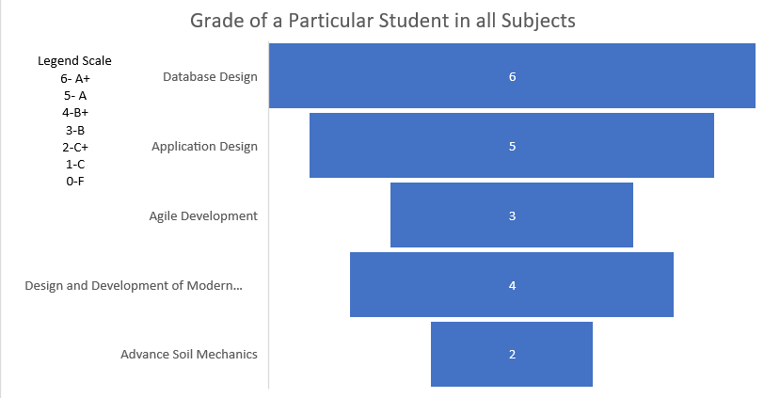
Popular Courses Report
Reports Screenshots

Slide 8

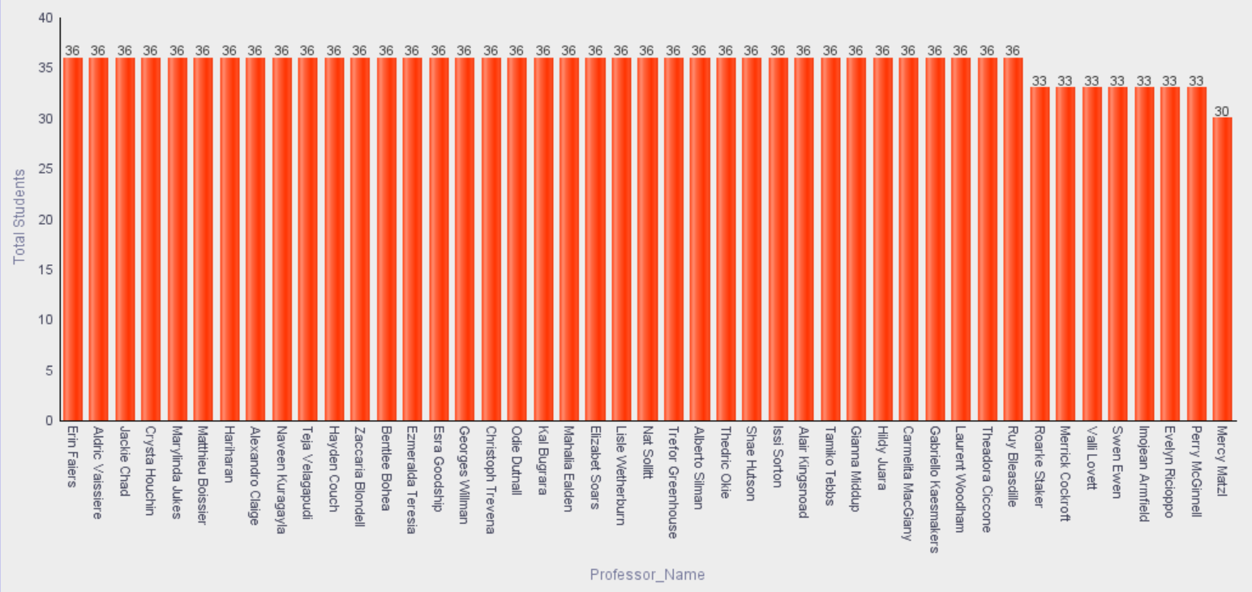
Popular Courses Report

Slide 9

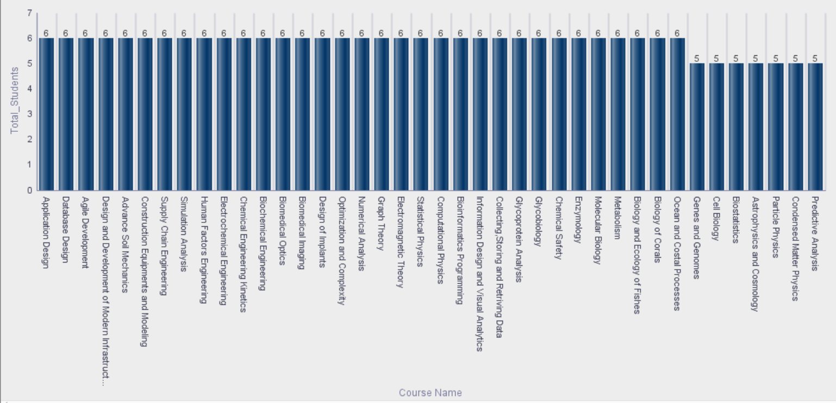
Popular Courses Report

Slide 10

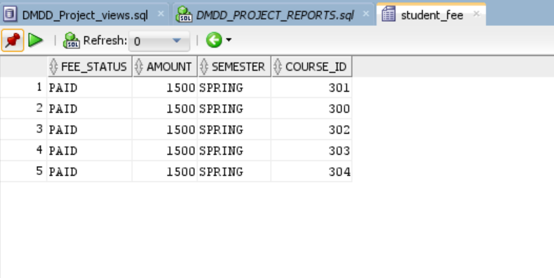

Slide 11

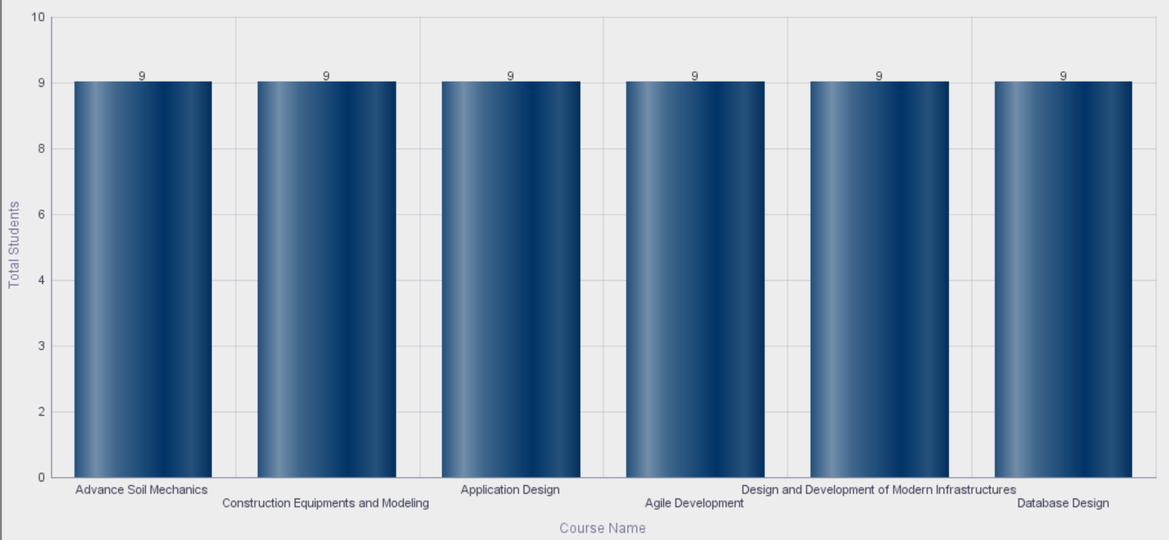

Slide 12


